Slide 1
The Technology Value Stream
MODULE 1.2 ASSIGNMENT
SPRING 2026 | CSD380 DEVOPS | AUTHOR: BRITTANEY PERRY-MORGAN

Slide 2

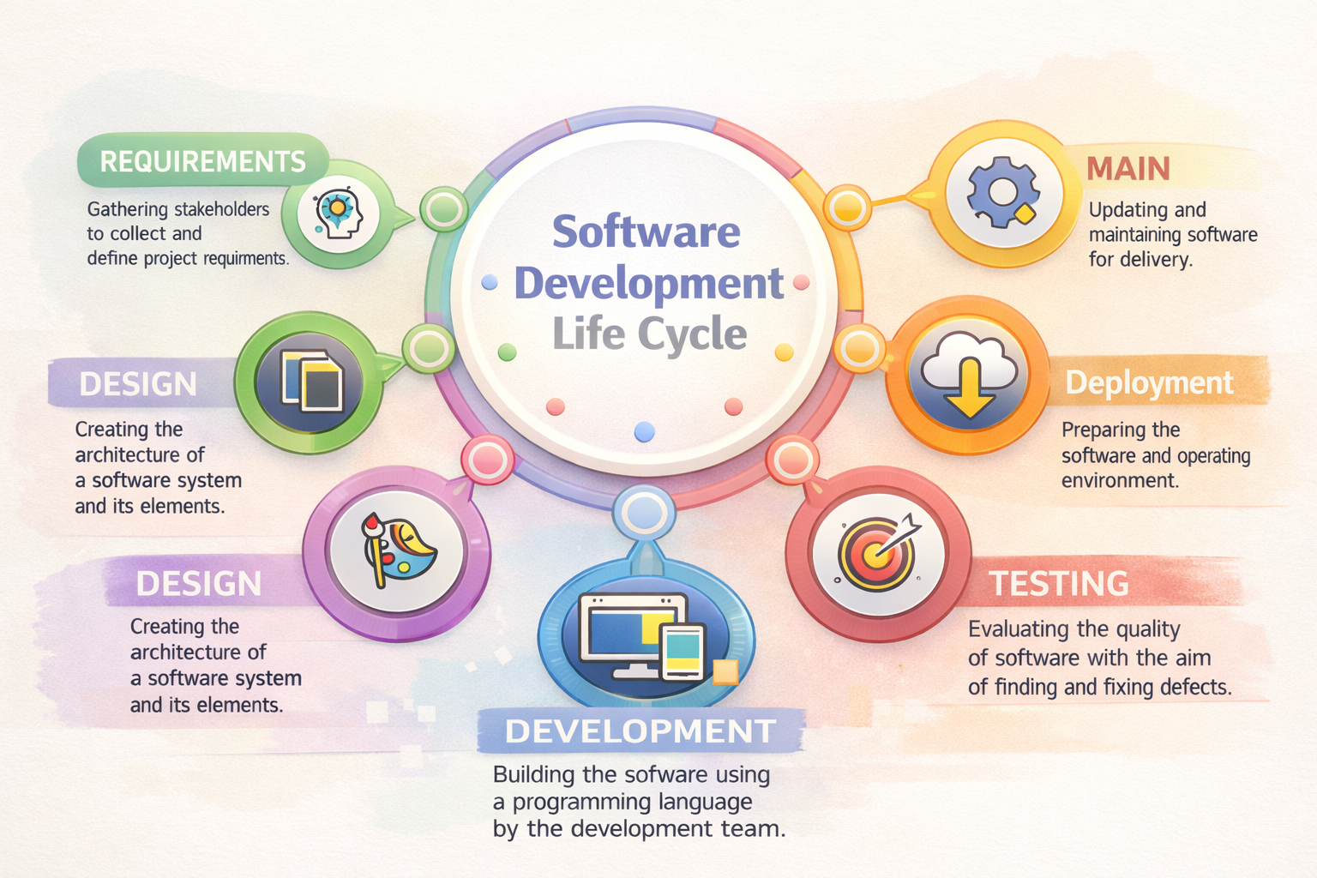
Introduction to the Value Stream
The Definition
The process of converting a business hypothesis into a technology-enabled service that delivers value to the customer.
The DevOps Connection
DevOps isn't just "tools"; it's the optimization of this specific stream to ensure agility and reliability.
Why It Matters
You can’t fix what you can't see. Mapping reveals the invisible "bottlenecks" where work goes to die.
Source: Horsthofer-Rauch, J., et al. “Digitalized Value Stream Mapping: Review and Outlook.” Procedia CIRP, 2022.

Slide 3

The Three Ways & Value Stream Mapping
The First Way: Flow
Accelerating the movement of work from Development to Operations. Value Stream Mapping is the primary tool to enable this.
The Second Way: Feedback
Shortening and amplifying feedback loops to fix quality at the source and prevent downstream problems.
The Third Way: Learning
Creating a culture of continual experimentation and risk-taking, learning from both success and failure.
Source: Paasivaara, M., et al. “FLOW-Assisted Value Stream Mapping...” Journal of Systems and Software, 2016.

Slide 4
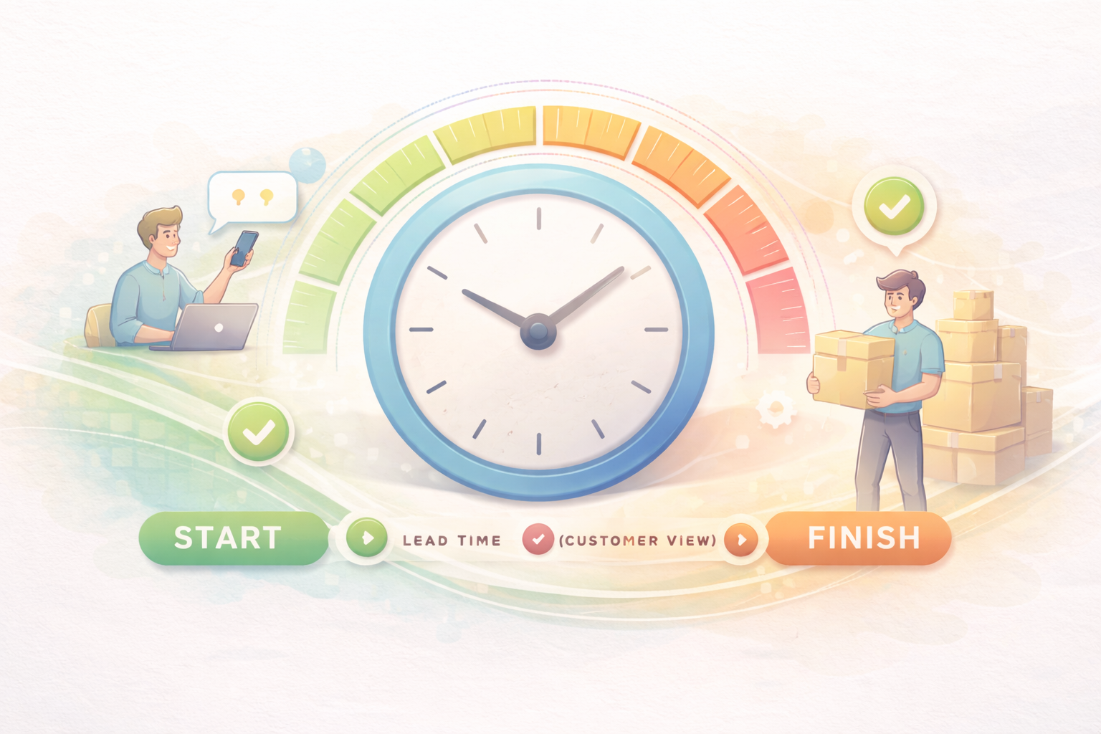
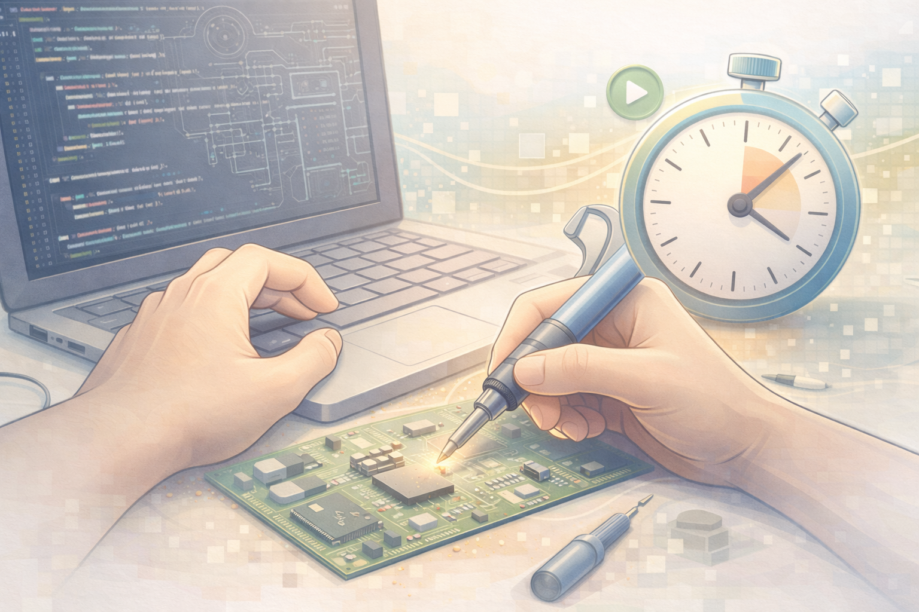
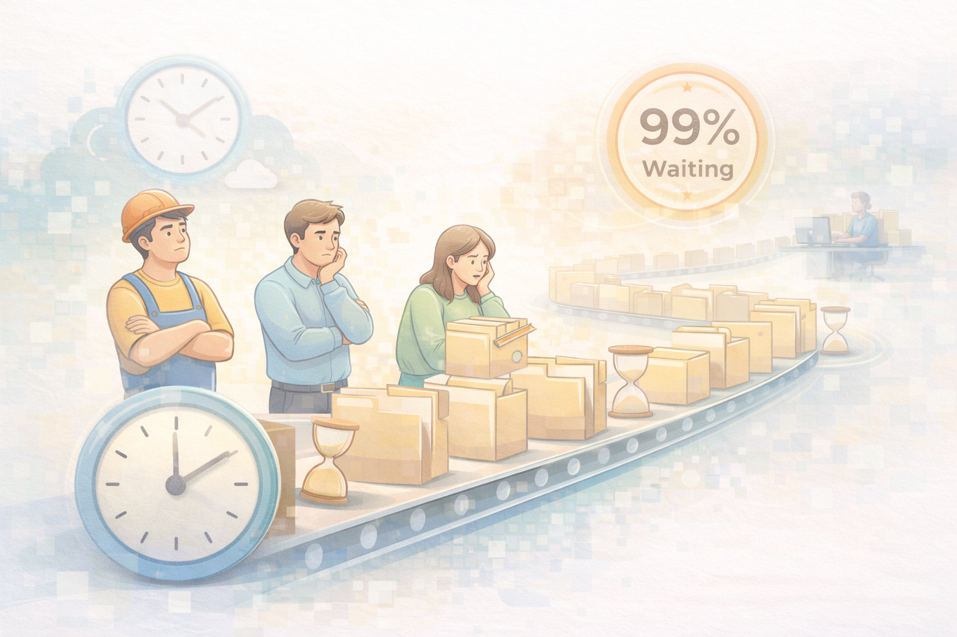
Lead Time vs. Processing Time
Lead Time (Customer View): The "clock" starts when the request is made and ends when it is fulfilled.
Processing Time (Engineer View): The actual time spent "touching" and working on the task.
Reality Check: In traditional orgs, work spends 99% of its time waiting in queues.
Optimization should focus on the wait, not work.
Source: Kim, Gene, et al. The DevOps Handbook, 2021; Middleware, 2023.

Slide 5
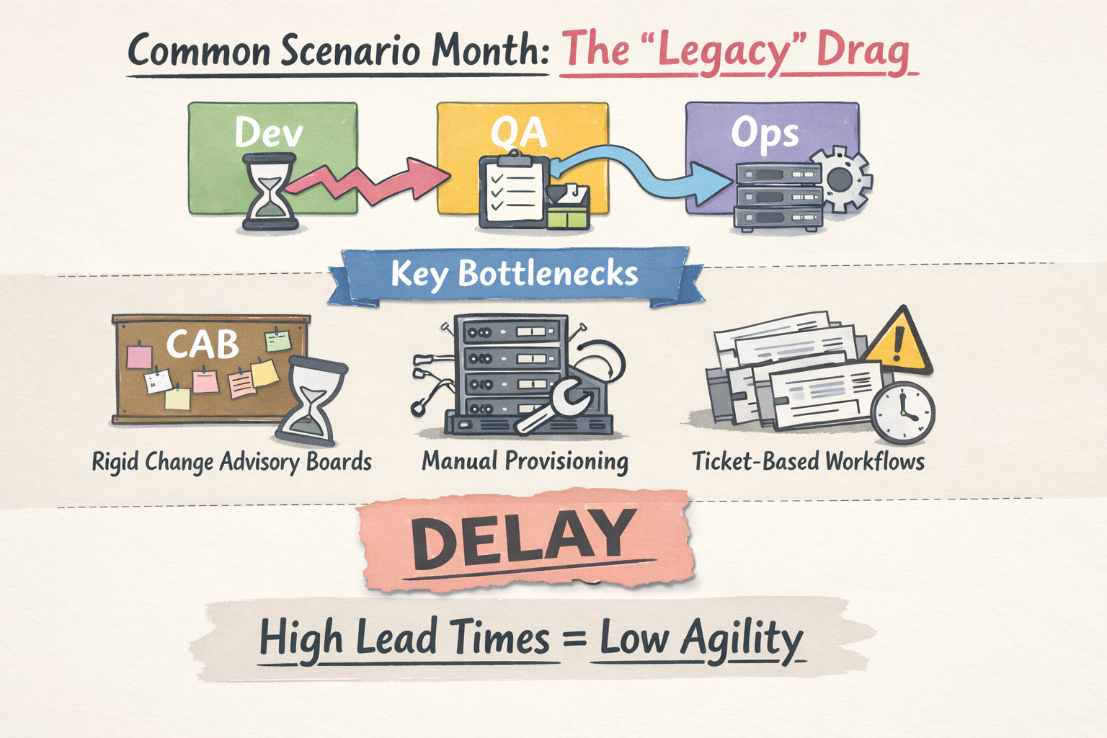
Source: 2024 DORA Accelerate State of DevOps Report.

Slide 6
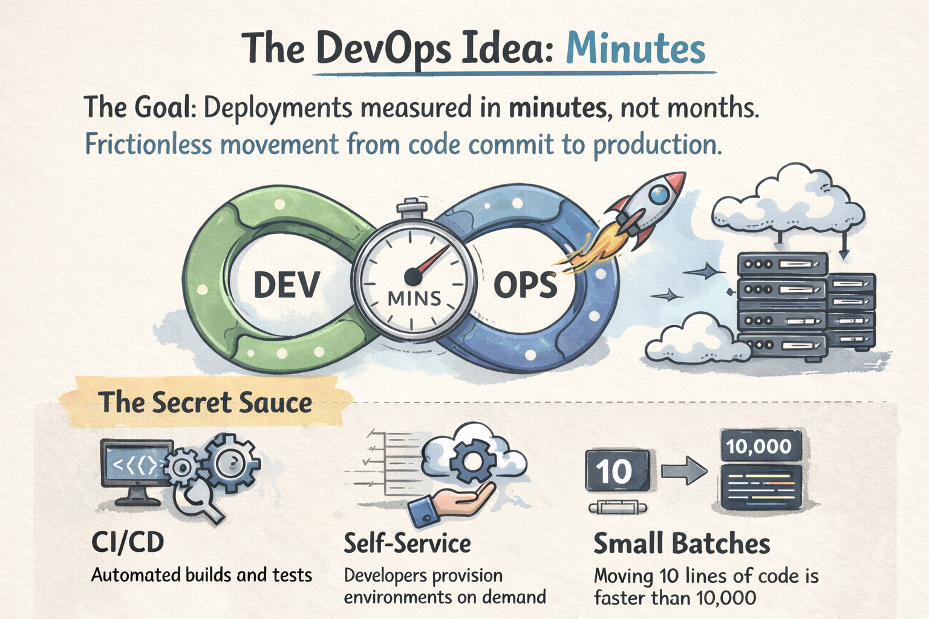
Source: DevOpsGuys, 2024; Kim et al., 2021.

Slide 7
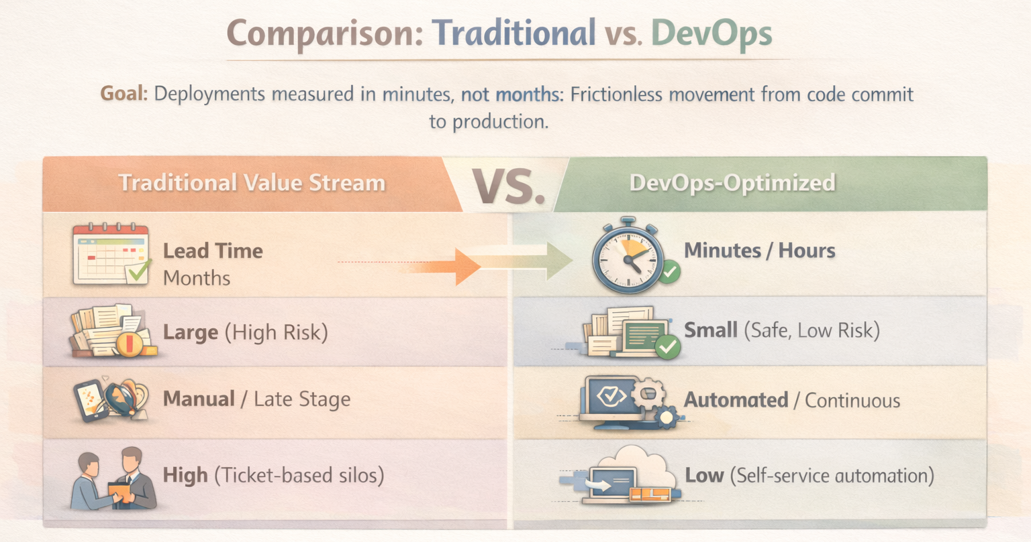

Slide 8

Case Study: Trust Bank
The Challenge
Traditional banking lead times were slowing innovation and market response.
90%
The Solution
Implemented AWS and Harness for automated delivery pipelines, moving away from manual gates.
The Impact
Massive increase in deployment frequency without sacrificing stability, proving that speed and safety are not tradeoffs.
Reduction in Lead Time
Source: AWS, 2025; Google Cloud DORA Awards, 2024.

Slide 9

Optimizing the Value Stream
1. Map Current State
3. Design Future State
Document every step, specifically highlighting the "waiting" periods between active work.
Automate the identified bottleneck. Create a plan for a streamlined flow.
4. Iterate
2. Identify Bottlenecks
Optimization is a marathon, not a sprint. Keep measuring DORA metrics and improving.
Find the longest wait times—usually approvals, manual testing, or provisioning.
Source: Shipyard, 2024. “How to Measure DORA Lead Time for Changes.”

Slide 10
Conclusion & Works Cited
Recap
Optimizing the technology value stream is about visibility and removing friction. By shifting from large batches and manual gates to continuous flow and automation, organizations can achieve the DevOps ideal.
Works Cited
Kim, Gene, et al. The DevOps Handbook. IT Revolution Press, 2021.
“2024 DORA Accelerate State of DevOps Report.” DORA, 2024.
Horsthofer-Rauch, J., et al. “Digitalized Value Stream Mapping.” Procedia CIRP, 2022.
“Trust Bank Reduces Deployment Lead Time by 90%...” AWS, 2025.
“Metrics to Improve DevOps Performance.” SPKAA, 2024.

